Slide 1

2017 Bridge Pointe
Homes Association
Meeting
Clardy Elementary School
January 9, 2017
7 p.m.
www.bridgepointekcmo.com

Slide 2
Jason White
President

Slide 3
Welcome – Approve Agenda
Approve minutes of January 11, 2016 annual meeting

Slide 4
Welcome new neighbors!
18 Homes Sold in 2016
Tony and Erika Costes 1601 NE 82nd Ter
Billy and Neele Lichner 1504 NE 82nd Ter
Chris and Amber Webster 8334 N. Highland
Josh and Tatiana Altena 1501 NE 82nd Ter
Craig and Heidi Knaak 109 NE 82nd Ter
Joel and Noelle Kitzman 8249 N. Wane Ct
Randy and Lorrae Groff 8305 N. Flora
Mark and Carrie Depetre 1934 NE 83rd St
Greg and Heather Olmstead 8341 N. Flora

Slide 5
Welcome new neighbors!
Logan and Kristin Anderson 8337 N. Highland
Cameron and Nicole Pennington 1426 NE 83rd St
Jimmy and Trisha Davis 1608 NE 83rd St
Grace and Pius Orji 8242 N. Flora
Russ and Samantha Oswald 1705 NE 82nd Ter
Kenan and Erna Karaga 8260 N. Woodland
Michelle Burkes 8302 N. Highland
Dennis and Alycia Woodman 8313 N. Highland
David and Maggie Lindell 8233 N. Flora

Slide 6
Year in Review
Continued to catch up and looking to the future!
5 year plan – significant project/commitment of time
Tremendous amount of work done on behalf of the neighborhood by board and volunteers

Slide 7
Key Accomplishments
Increase in communications
5 Year Plan developed to be updated yearly
Key Fobs at pool went smoothly – includes reporting..\log_20160813102240.xls
New Pump/Filter worked well and saved water
Reserves/Cash, allowed for fall painting and repair of pool
2017 looks to be first year to significantly increase reserves for large projects/maintenance on horizon

Slide 8
Block Captain Program
Block Captain Leader:
Linda Van Dyke

Slide 9
BLOCK CAPTAINS
Carolyn McClure
Irene Siedler
Susan Baumgartner
Janet Harrington
Mary Jacobi
Jackie Clifton
Jill Dickson
Dee Breedlove
Patty Meek
Joyce Leimkuhler
Mary Kay Frommelt
Joy McManus
Mary Wilkens
Tana Stock
Al Neal
Linda Jones
Marcie Van Dyke
Doris Crews
Graden Snow
Linda Spotts Michael
Paul Link

Slide 10
Chad Brantley
Vice-President

Slide 11
Thank 2016 Coordinators of activities and programs
TGIF
Barbeque Show Down
Garage Sale
Independence Day Parade
Welcome Wagon
Pool Party
Oktoberbest
Egg Hunt
Shuffleboard Tournament
Dumpster Days
Flags
The Pointe
Website – pics/articles/ideas
E-mail news

Slide 12
Regular Activities for 2017
Garage Sale
BBQ Showdown
Egg Hunt
Independence Day Parade
Pool Party
Dumpster Days
Oktoberfest
Shuffleboard
Monthly TGIF Social Hours
Monthly Kitchen Table Poker

Slide 13
Coordinator Needs
Garage Sale
Egg Hunt
Website pics/articles/happenings
-------------------------------------------------------------------------
Volunteer Needs
Garage Sale Signs
Dumpster Day
Painting of Pumphouse Bathrooms
Pool Closing lockup (weekly)

Slide 14
NEW ACTIVITIES
for 2016
Ideas always welcome – contact a board member directly

Slide 15
COMMUNICATIONS
Website – www.brigepointekcmo.com
E-mail network – coordinated by Mike Power (Sign up to get news at mikerewop@gmail.com)
Facebook – (sign up at facebook.com.)
The Pointe - Newsletter

Slide 16
Joanne Link
Treasurer

Slide 17
2016 Financials
• TOTAL INCOME $ 68,091.62
• TOTAL EXPENSES $ 62,843.65
Activities = $1,504.71
Landscaping = $9,010.56
Pool = $37,745.11
Utilities = $8,335.16
Misc = $6,248.11

Slide 18
2016 Financials
• CASH ON HAND:
(as of 12-31-16) $ 1,534.66 (Checking)
• Reserves: $12,398.24
Reserves add for 2016 = $5,299.00
  (negative net income last year)

Slide 19
P&L
2017 Budget

Slide 20
Matt Ryan
Pool Chairman

Slide 21
Pool Improvements / Changes
Paint – restrooms
New “Rules” Sign
Shade on pergola
Plumbing repaired
Auto Light switches
New Timer for parking lot lights
New LED lighting
New Key Fob system
New Pump/Filter
Painting/tile repair/skimmers done this fall on pools
Wifi/internet
Termite Treatment

Slide 22
Pool 2017 Plans
Chair Replacement
Staining of pergola in fall
Step Painting on entrance
Finish painting restrooms/Doors
Safety equipment and city requirements
Continue looking at screen repair options

Slide 23
Bob Hiatt
Landscaping

Slide 24
Projects Completed
Bushes/Area on NE side of pool
Entry sign lighting and wiring
New Contract on maintenance
Trees and Limbs Removed by Pool
North Wayne entrance sign painted

Slide 25
Projects for 2017
Grass Plants behind pool parking lot
Sealing of retaining wall on North Wayne
Tops of posts at main entrance to be painted
Drainage concerns behind pumphouse

Slide 26
Jeff Lee
Architecture/Compliance

Slide 27
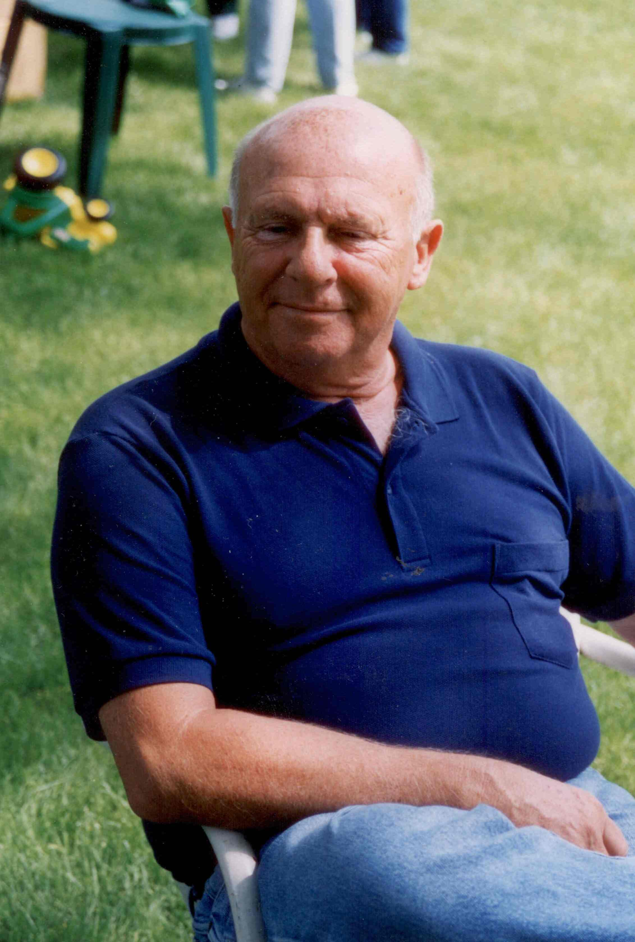
Larry Hanson
Good-Neighbor Award
for
outstanding service
to
Bridge Pointe

Slide 28
Brian McCrary
Recipient of
2016 “Larry Hanson
Good Neighbor Award”

Slide 29
New Business

Slide 30
Vice President Chad Brantley leaving position
Architecture Chair Jeff Lee leaving position

Slide 31
Election of
Board Members
President – Jason White Vice President – Christi Smith
Pool Chair – Matt Ryan
Landscaping Chair – Bob Hiatt Secretary – Kristy Cofer
Treasurer – Joanne Link Architecture – Terry Crawford

Slide 32
Drawing for gift cards and 50/50 Raffle
Thank you for attending.
www.bridgepointekcmo.com

